Slide 1
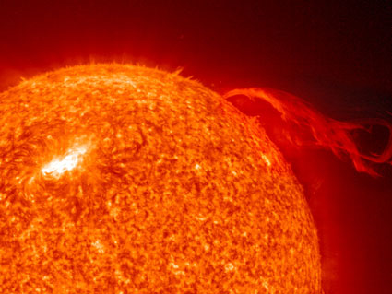
Coronal Mass Ejection
By: Tina Henning
Mentors: O. C. St. Cyr, Hong Xie
Heliophysics Science Division
Code 670

Slide 2

Animation of the STEREO-A spacecraft observing a very active Sun. Credit: Walt Feimer, NASA

Slide 3
Coronal Mass Ejections
CMEs are explosions in the Sun's corona that spew out solar particles which can be dangerous when they hit the Earth
CMEs will become more and more frequent as we near solar maximum

Slide 5
CME’s can:
Cause Aurora
Effect Satellites
Effect Power grids
Effect Radio communications

Slide 6
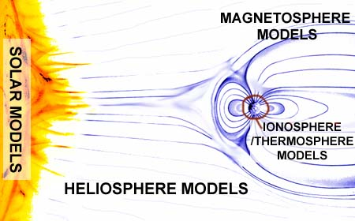

Slide 7
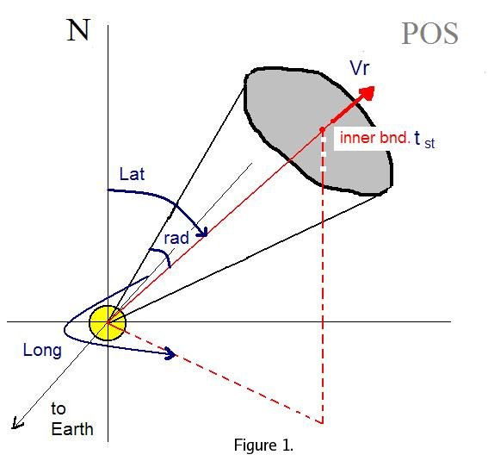
ENLIL takes the cone model input parameters at its inner boundary.
These input parameters are the following:
1. Start date (yyyy-mm-dd)
2. Start time (hh-mm) 3. Cone latitude (deg) 4. Cone longitude (deg) 5. Cone radius (deg) 6. Radial velocity (km/s)

Slide 8
20000210_ 0230_1154

Slide 10
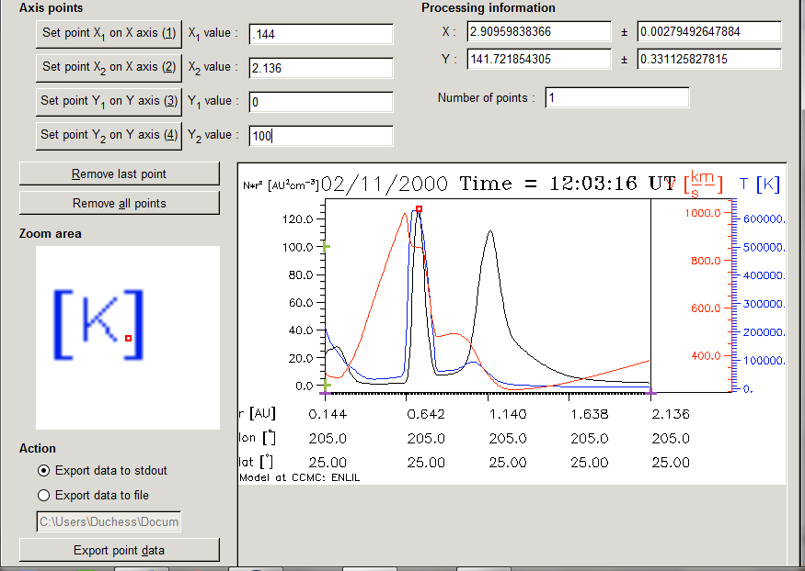

Slide 11
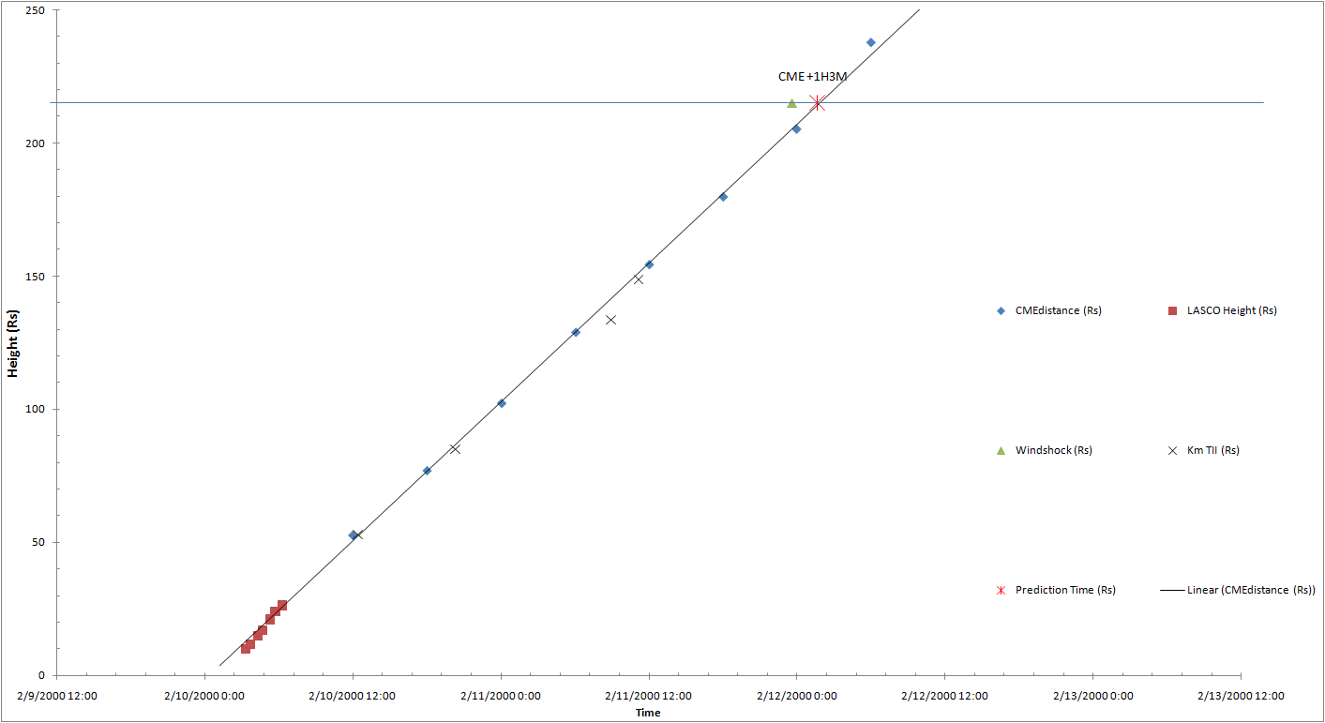

Slide 12
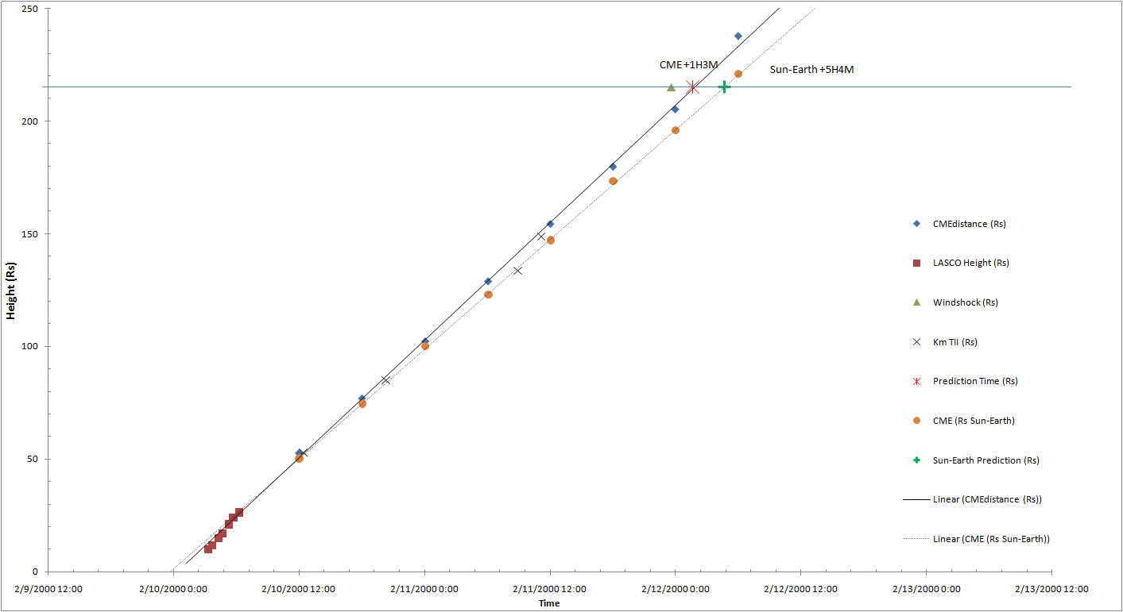

Slide 14
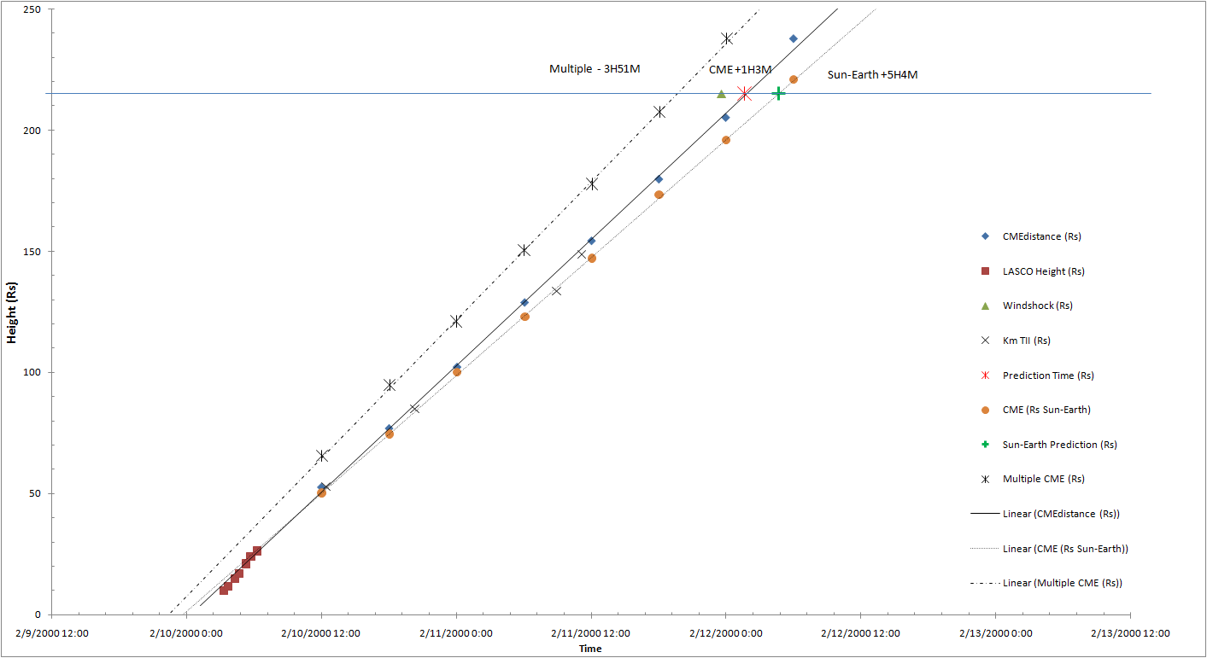

Slide 15
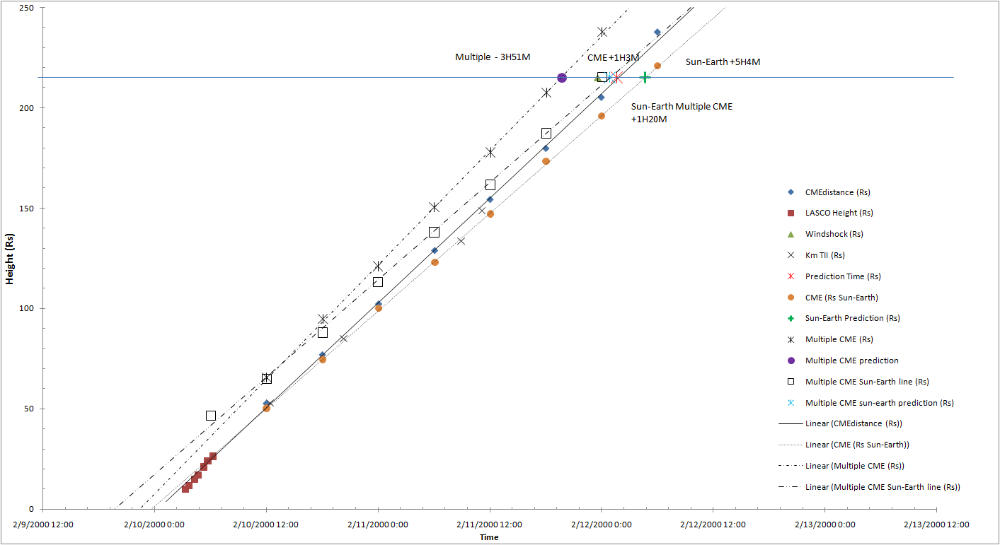

Slide 16
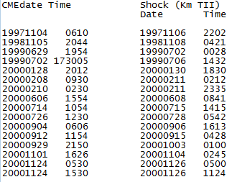
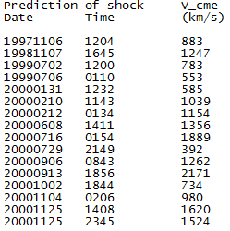
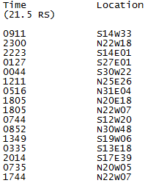

Slide 17
conclusion
Want to predict when space weather events from the Sun will hit Earth
Believe the best way to do this is to use sophisticated models; ENLIL is the first model
Preliminary results compare measurements with the radio measurements that were done before; results seem to be similar

Slide 18


